Slide 1
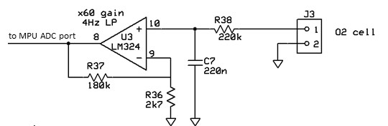
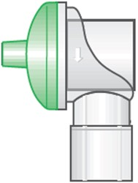
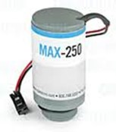
FiO2 sensor addition
PR is not required if the Blender incorporates a pressure regulator
Oxygen cell signal conditioning, to bring it into ADC range
PR
SV1
SV2
Ptr1
Oxygen 2.5 - 5bar
NR1 22mm
Blender
NC
NC
The cell has a linear response (deviates less than 1%) over the full 21% to 100% range.
The cell depletes over 2 – 4 years (depending on amount of oxygen exposure). The cell voltage drifts down during this time.
The cell needs calibrating at least monthly, when in use. Calibration steps:
Flow pure air, allow 30 sec to settle, measure the 21% value. If below 10mV, then warn about need to change cell (maintain low priority alarm, but allow ventilator use until 9mV).
Flow pure oxygen, allow to settle for at least 30 sec, measure the 100% value.
The 2 values are used to calculate the FiO2 from the cell voltage.
Air 2.5 - 5bar
Ptr2
SV3
NC
FR1
FR3
FR2
O2 cell
NR2 22mm
Cell reacts with oxygen, producing a voltage of about 13.5mV in ambient air
FR3 set to produce about 20mL/min sampling flow
https://www.maxtec.com/product/sensing/fio2/max-250/

